Slide 1





Data Science with Python

Slide 2

A Project on
Predicting Smoking Habits Using Health and Demographic Data: A Machine Learning Approach
Submitted for the Award of the requirement of the Program of EDGE: BU-CSE Digital Skills Training
To
Md. Mahbub-E-Noor
Assistant Professor
Department of CSE
University of Barishal
By
Ahammad Ullah Alid
Student ID: 211-004-19

Slide 3
Introduction
Background: Smoking has significant health implications, leading to higher healthcare costs and risks. Early identification of smokers can help tailor preventative health interventions. Predicting smoking habits using health and demographic data could help target at-risk groups more effectively.
Objective: The objective of this project is to predict smoking habits (smoker or non-smoker) using a machine learning approach, utilizing health and demographic features such as age, BMI, and medical insurance costs.

Slide 4
Dataset Overview
Dataset Source: Insurance dataset containing 1,338 records.
Features:
Age: Age of the individual.
Sex: Gender (male, female).
BMI: Body Mass Index (numerical).
Children: Number of dependents.
Region: Residential area.
Charges: Medical insurance costs.
Target Variable:
Smoker: Whether the person is a smoker (Yes/No).

Slide 5
Data Preprocessing
Steps Taken:
Encoded categorical variables (e.g., sex, region, smoker).
Scaled numerical variables (age, bmi, charges) for model compatibility.
Split data into training (80%) and testing (20%) sets.

Slide 6
Exploratory Data Analysis (EDA)
Key Findings:
Smokers tend to have higher medical charges than non-smokers.
Smokers have a slightly higher average BMI compared to non-smokers.
Geographical regions show variability in smoking prevalence.

Slide 7
Model Training and Evaluation
Metrics:
Accuracy: Proportion of correct predictions.
Precision: The accuracy of positive predictions.
Recall: How well the model identifies smokers.
F1-score: Harmonic mean of precision and recall.
ROC-AUC: Area under the Receiver Operating Characteristic curve.
Confusion Matrix: The confusion matrix shows how well the model distinguishes between smokers and non-smokers.

Slide 8
Model Selection
In this case,A person is a smoker or not based on various health and demographic features is a binary classification problem, where the target variable is either "smoker" or "non-smoker". Several types of models can be used for this kind of task. Such as
Logistic Regression
Random Forest Classifier
K-Nearest Neighbors (KNN)
Gradient Boosting (XGBoost)
Also could be used Neural Networks (Deep Learning), Naive Bayes, Support Vector Machine (SVM) Model.

Slide 9
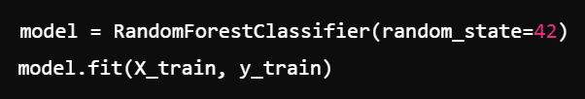

Using Random Forest Classifier
For this data set (data.csv) file we used the Random Forest Classifier Model.
Initialize and Train the Model:
After training the model, To make Prediction:

Slide 10
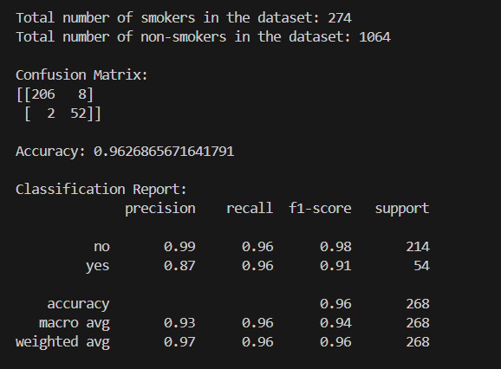
Output of RFC

Slide 11
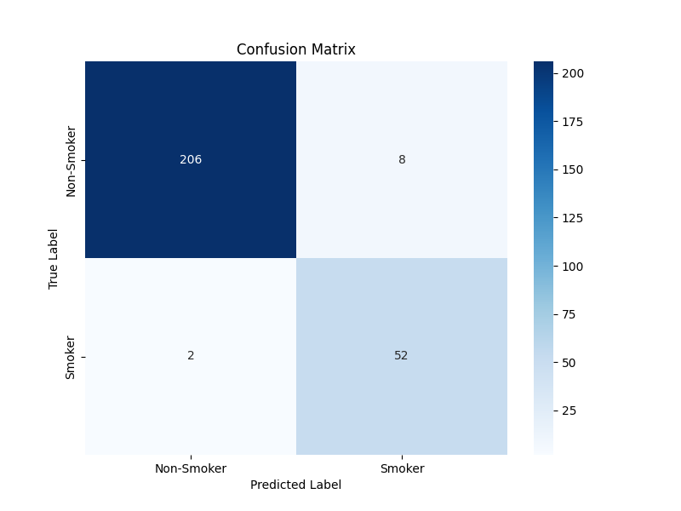
Graphical Visualization

Slide 12
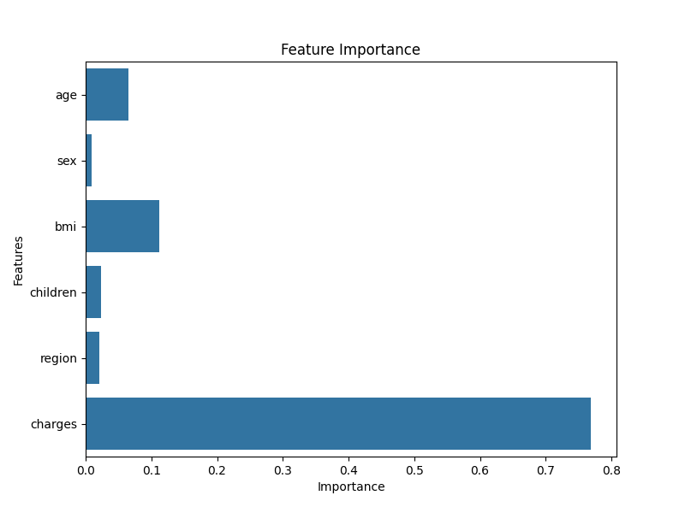
Graphical Visualization

Slide 13
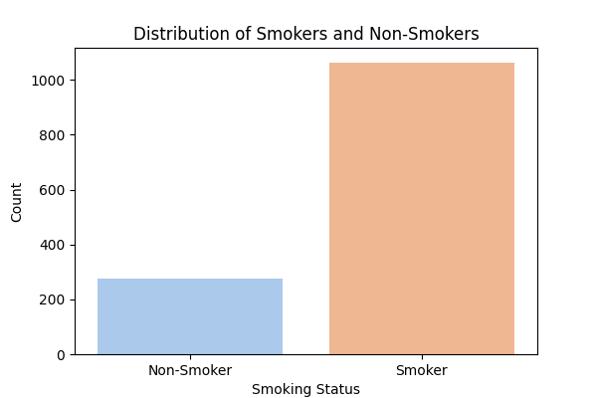
Graphical Visualization

Slide 14
Comparative Results
Results:
Random Forest: ___% accuracy
Logistic Regression: ___% accuracy
Gradient Boosting: ___% accuracy (best performer)

Slide 15
Feature Importance
Key Features Influencing Predictions:
Charges: Strongest predictor of smoking status, with smokers having higher medical costs.
BMI: Indicates lifestyle factors like diet and activity level, which can correlate with smoking habits.
Region: Certain regions show higher percentages of smokers, which suggests environmental factors.

Slide 16
Future Work
Recommendations:
Incorporate additional features such as income, physical activity levels, and lifestyle factors.
Test the model on larger, more diverse datasets to ensure robustness.
Explore deep learning models or more advanced ensemble techniques for potential improvements in prediction accuracy.

Slide 17
Conclusion
Summary:
The model accurately predicts smoking status with significant performance improvement using Gradient Boosting.
Key predictors include medical charges, BMI, and region.

Slide 18


